Slide 1
Modern Yazılım Mimarileri
Notes:
‹#›

Slide 2

Kaynakça

Slide 3
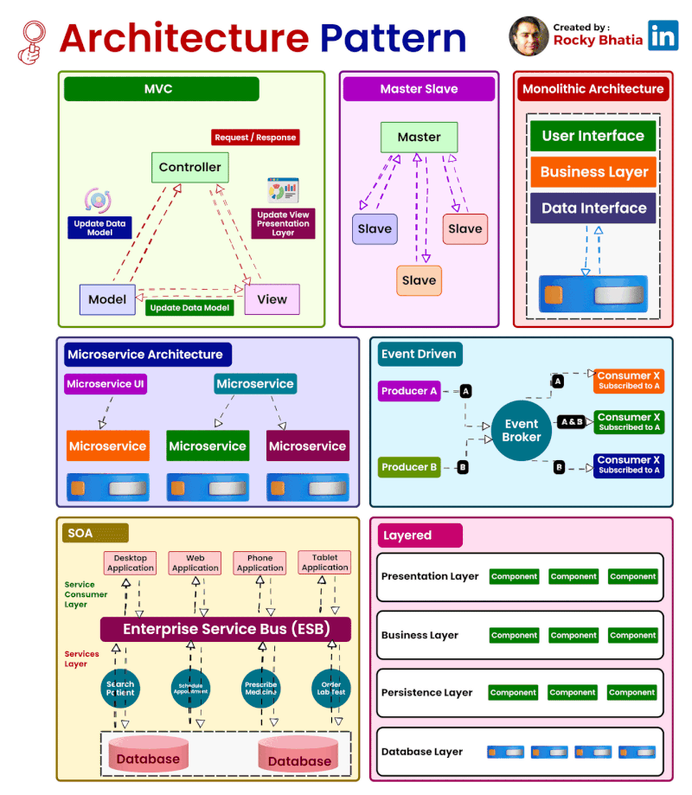
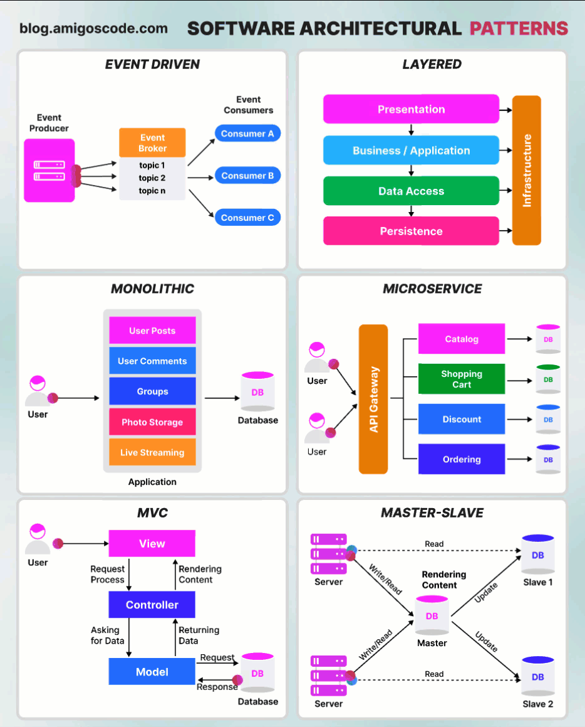
Architectural Patterns

Slide 4
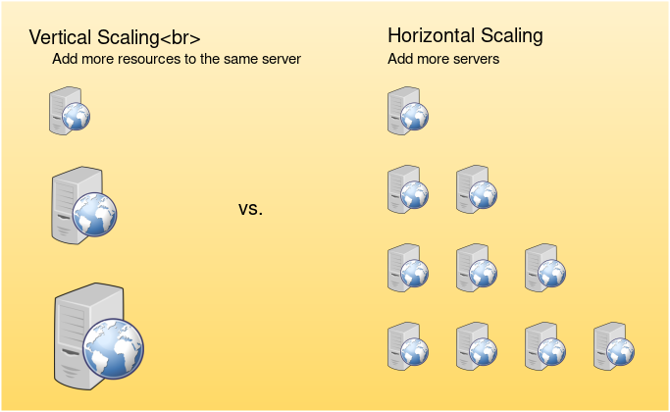
Scaling

Slide 5
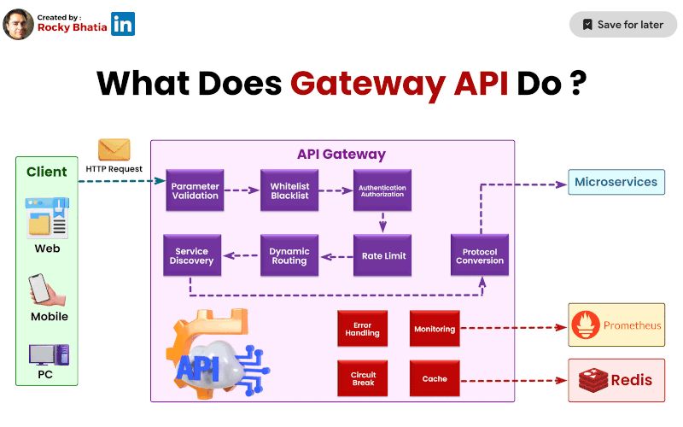
API Gateways

Slide 6
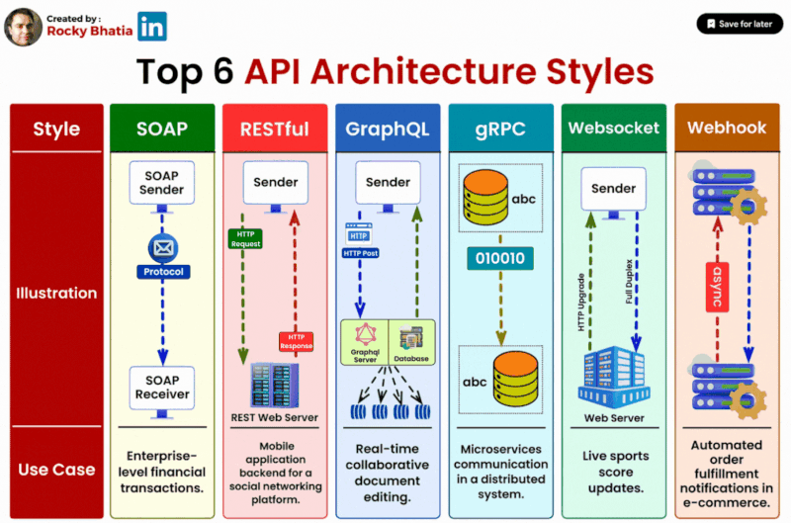
Scaling

Slide 7
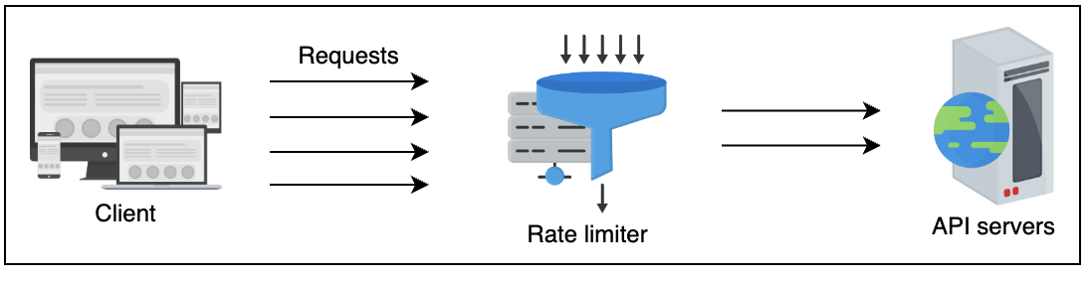
Rate Limiter

Slide 8
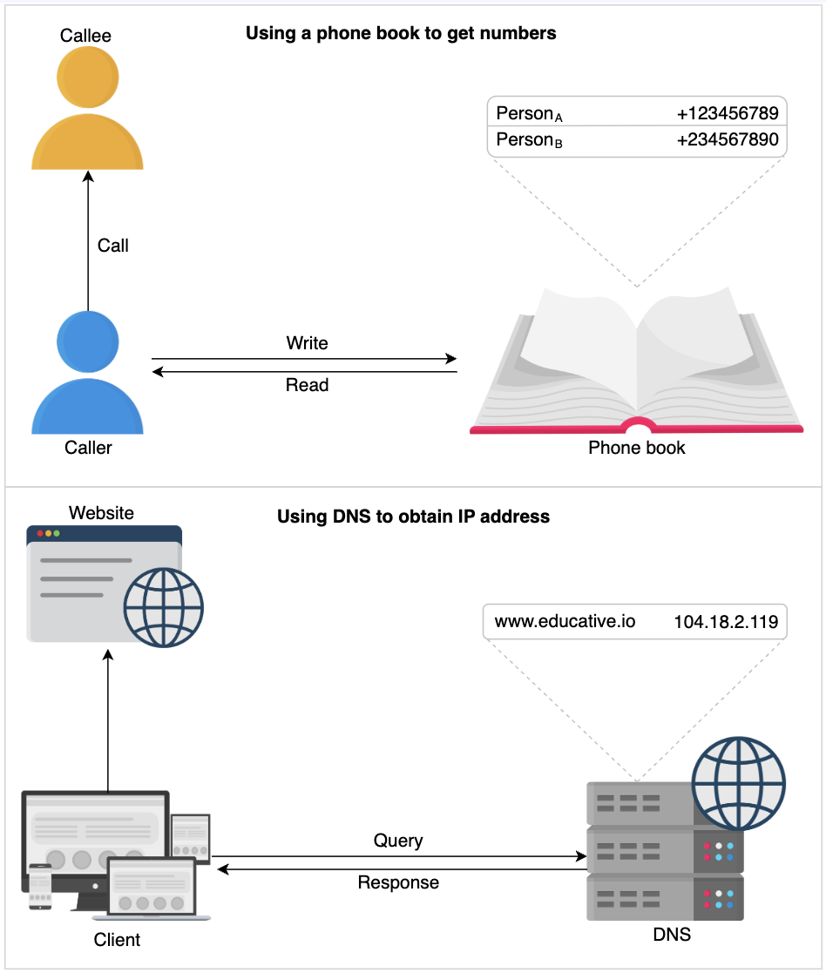
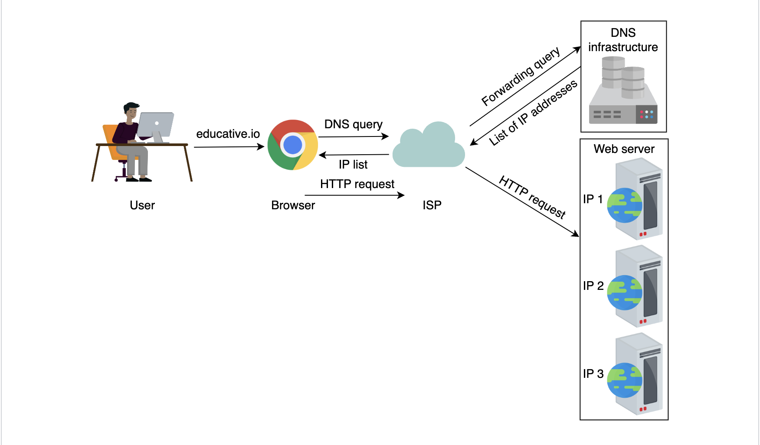
Domain Name System (DNS)
https://www.educative.io/courses/grokking-modern-system-design-interview-for-engineers-managers/introduction-to-domain-name-system-dns

Slide 9
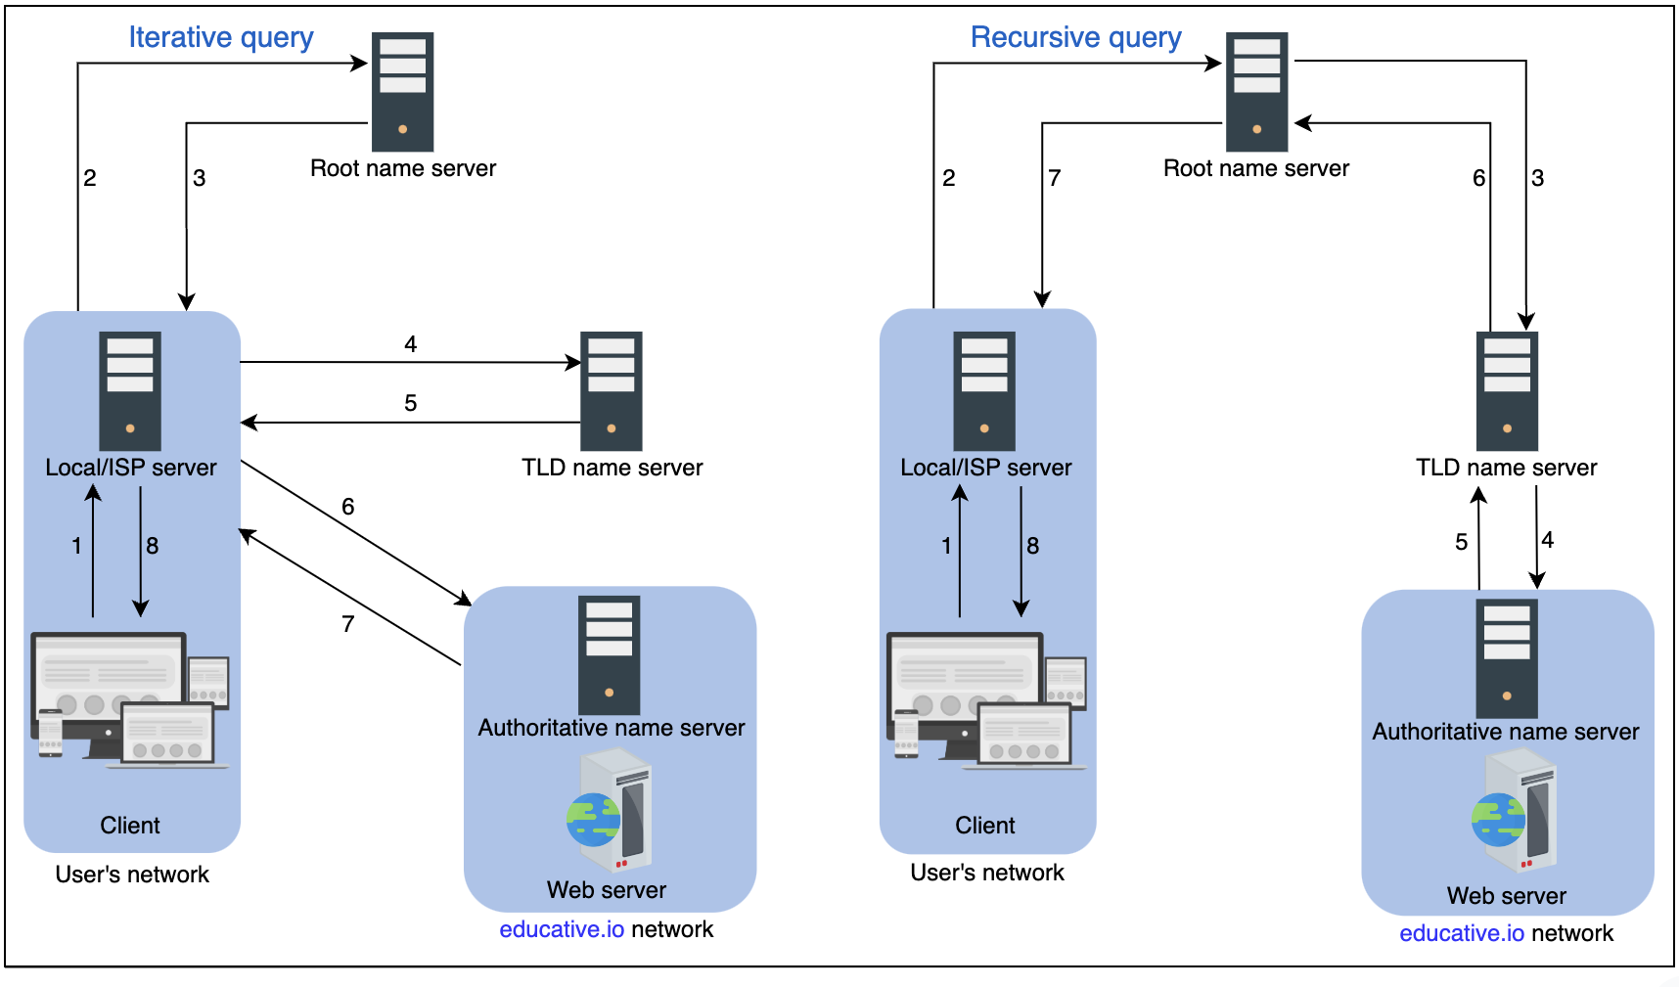
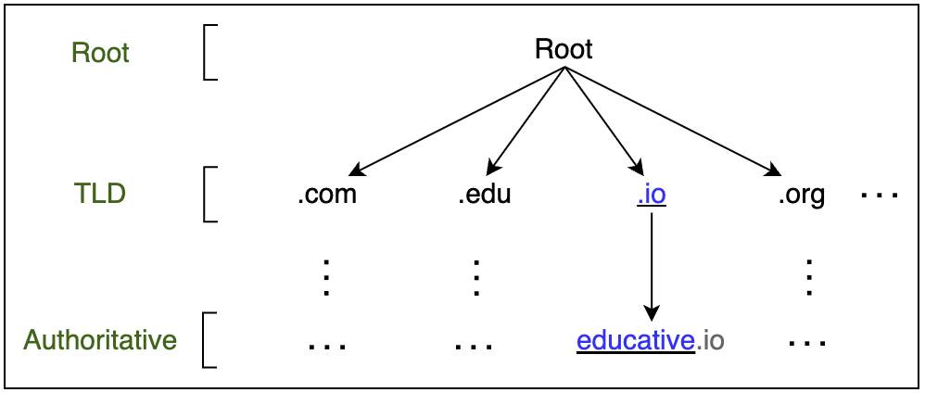
How the Domain Name System Works
https://www.educative.io/courses/grokking-modern-system-design-interview-for-engineers-managers/introduction-to-domain-name-system-dns

Slide 10
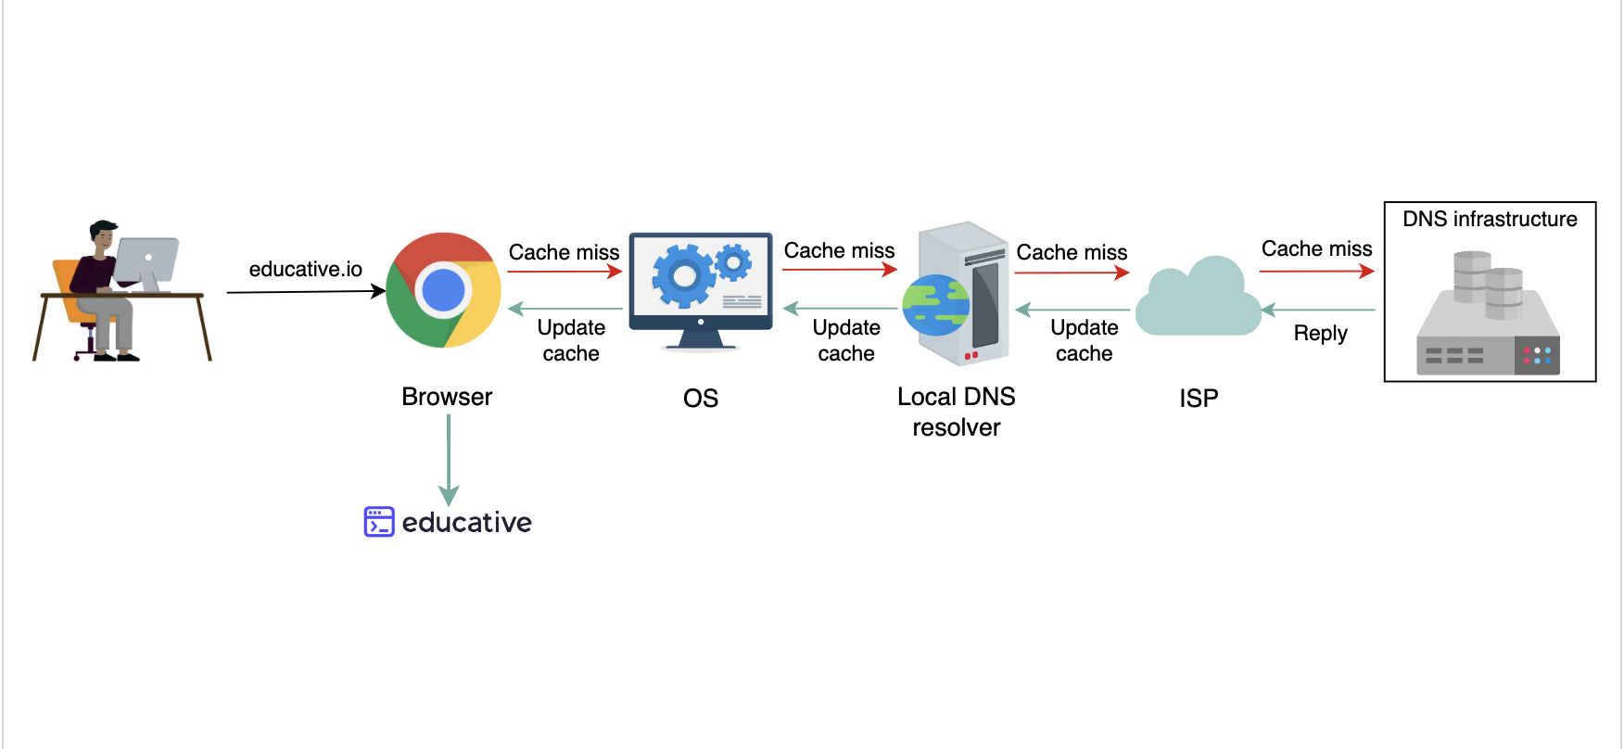
How the Domain Name System Works
https://www.educative.io/courses/grokking-modern-system-design-interview-for-engineers-managers/how-the-domain-name-system-works

Slide 11
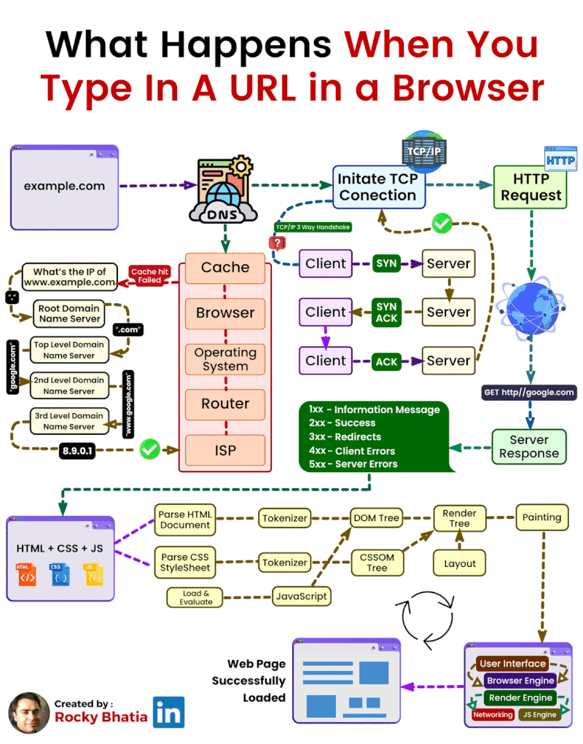
How the Domain Name System Works

Slide 12
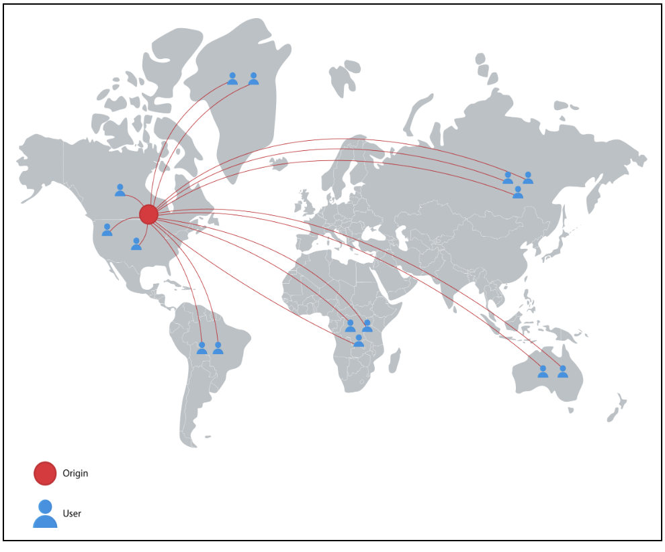
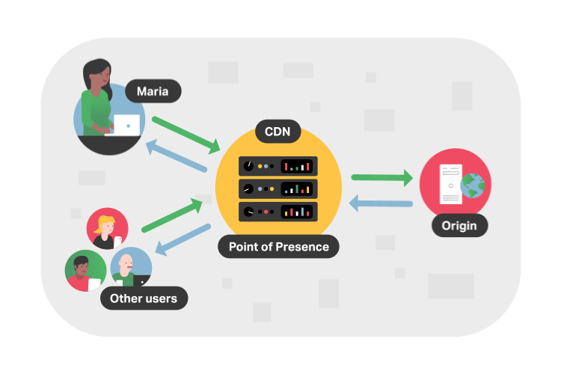
Content Delivery Network (CDN)

Slide 13
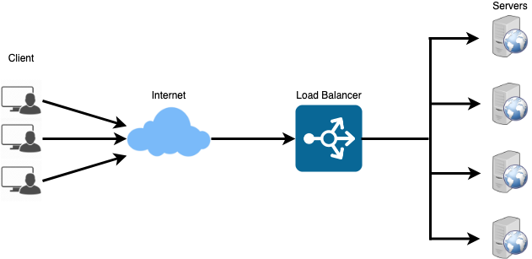
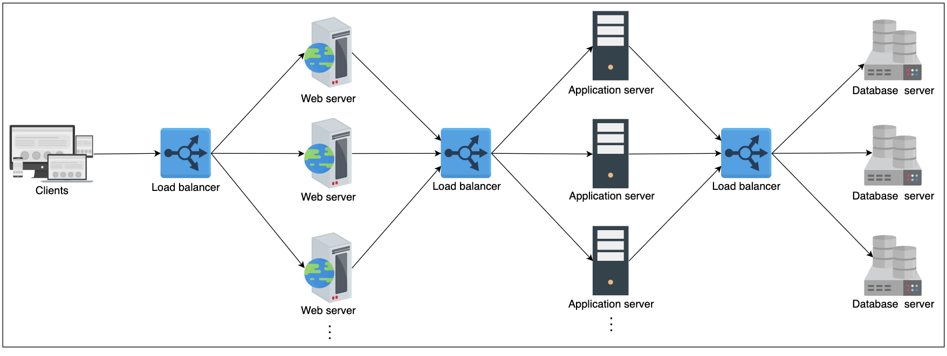
Load Balancing
Between the user and the web server
Between web servers and an internal platform layer, like application servers or cache servers
Between internal platform layer and database.

Slide 14
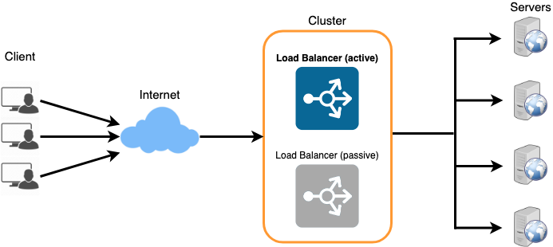
Load Balancing
Kullanıcılar hızlı hizmet alır, istekleri anında yönlendirilir.
Hizmet sağlayıcılar az kesinti yaşar, yük dengeleyici sorunlu sunucuyu atlayarak sağlıklı bir sunucuya yönlendirir.
Yük dengeleme, sistem yöneticilerine istekleri kolayca yönetme olanağı sunar.
Akıllı yük dengeleyiciler, trafik sorunlarını önceden belirleyerek organizasyonlara bilgi sağlar.
Sistem yöneticileri, yük dengeleme ile sorunları azaltarak daha verimli çalışır.

Slide 15
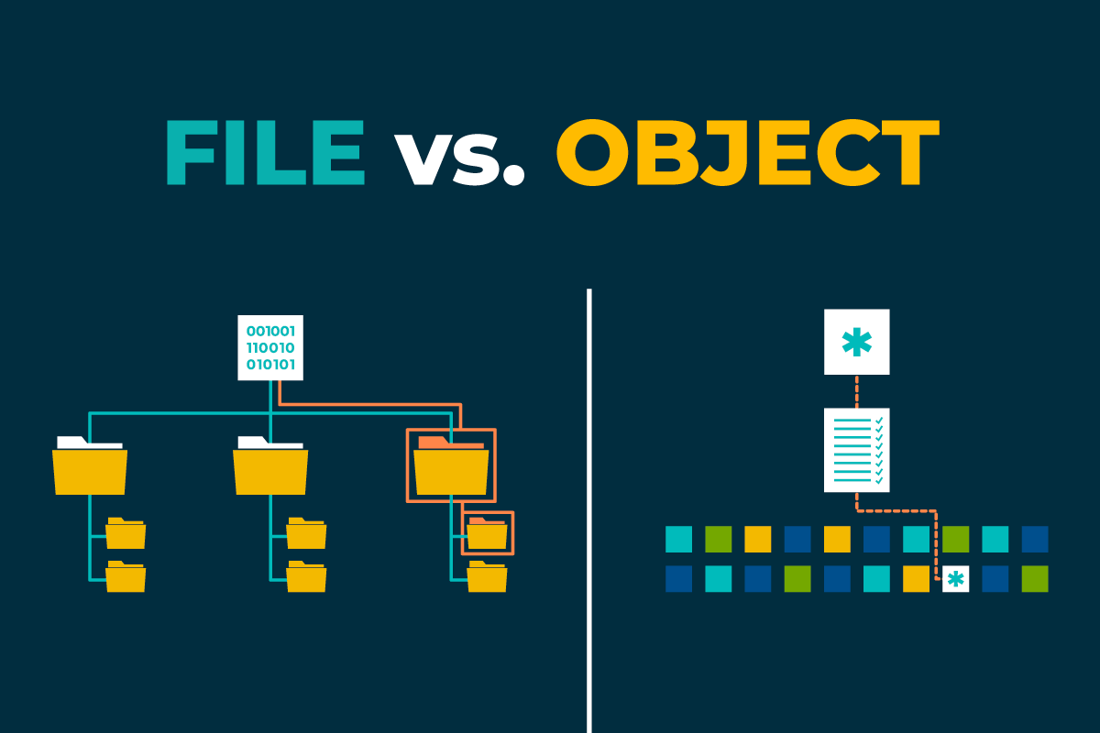
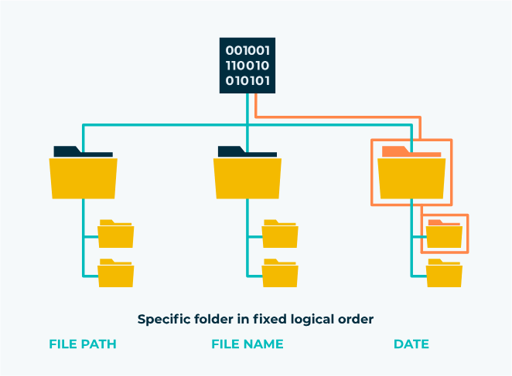
File storage

Slide 16
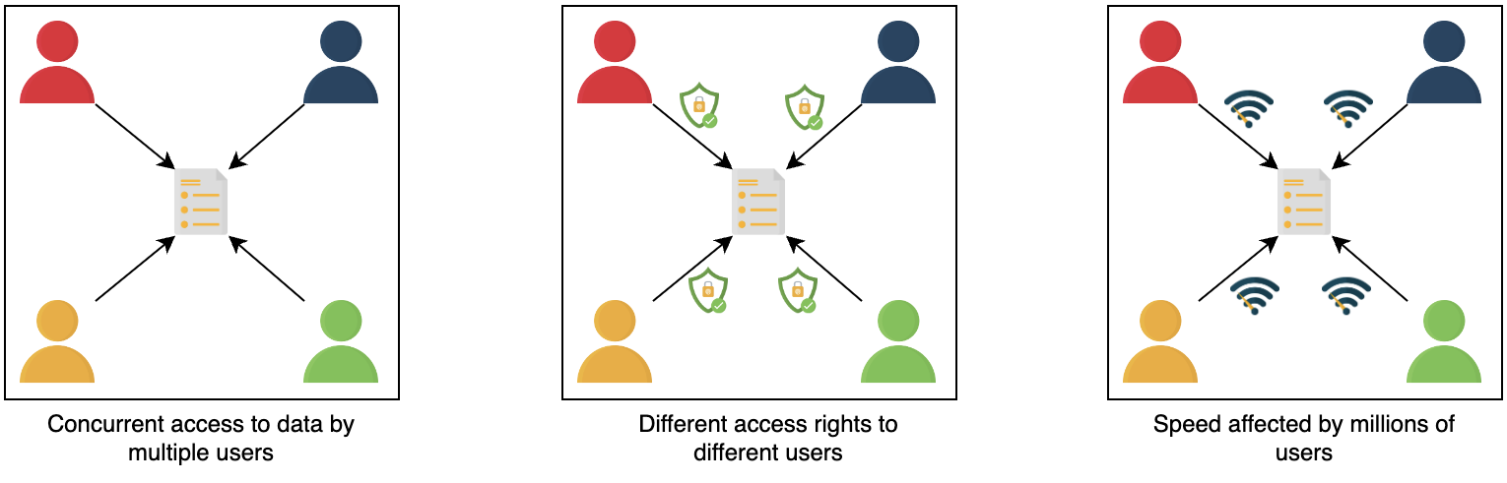
Limitations of file storage

Slide 17

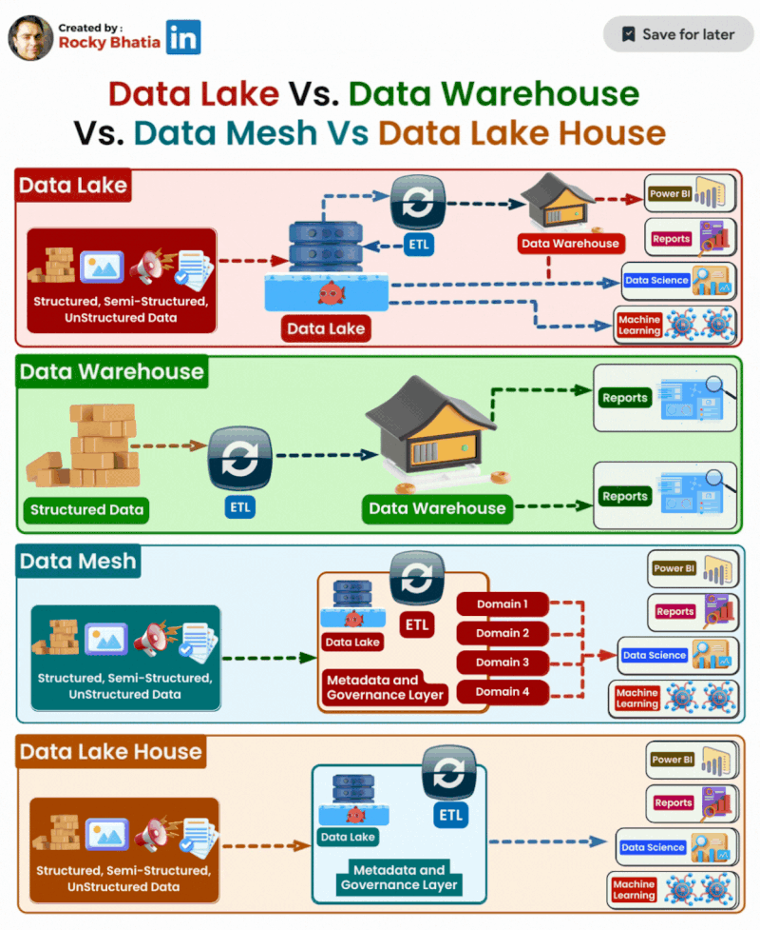
Database

Slide 18
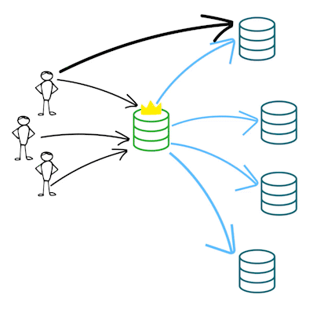
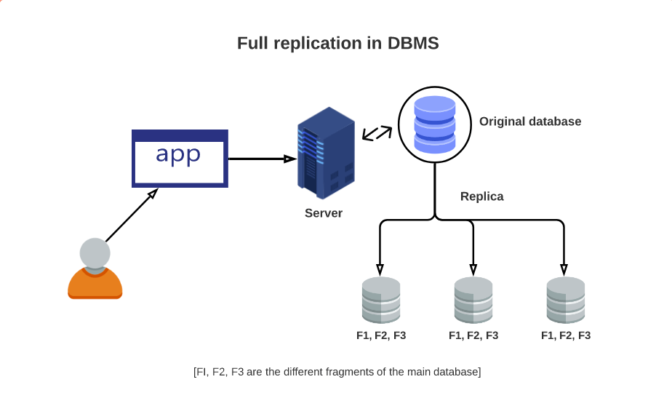
Replication

Slide 19
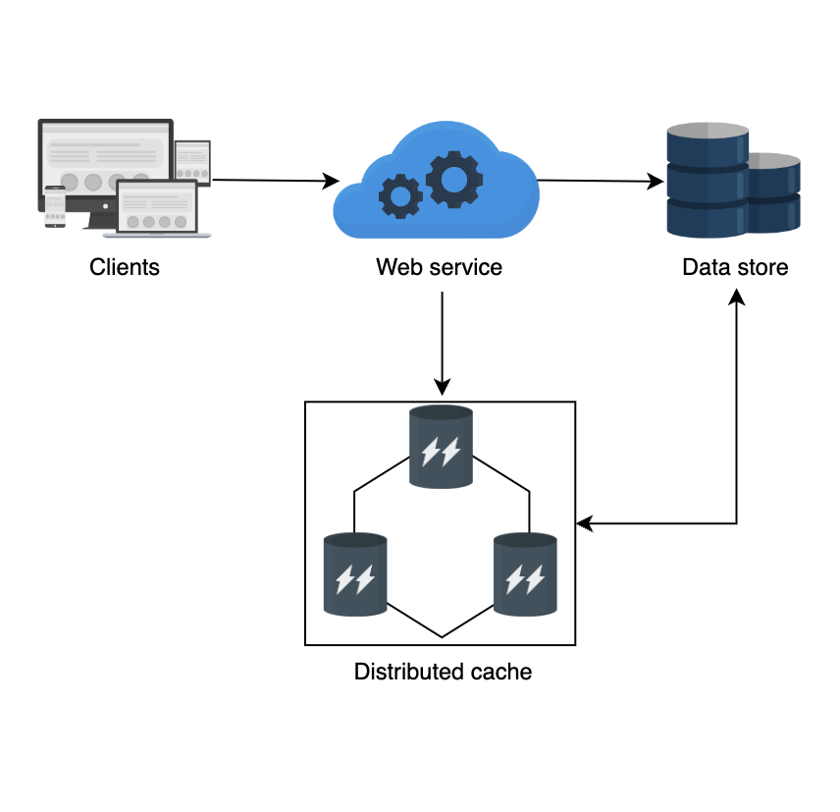
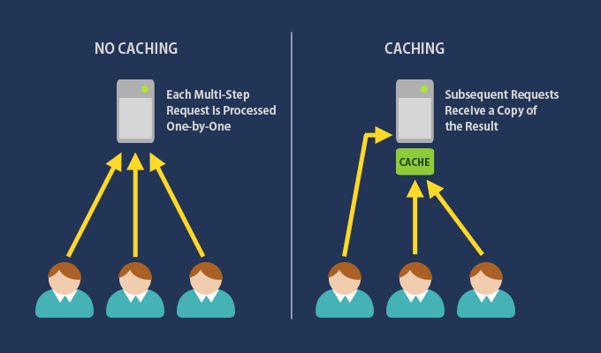
Caching

Slide 20
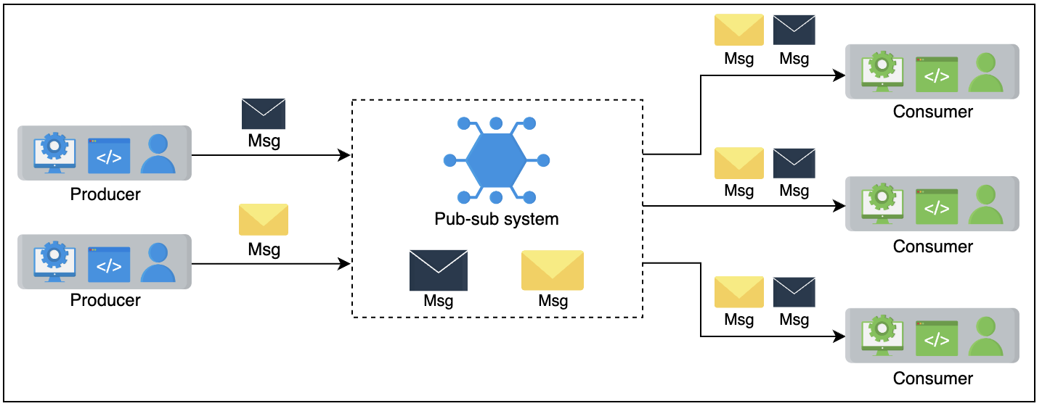
Pub-sub

Slide 21
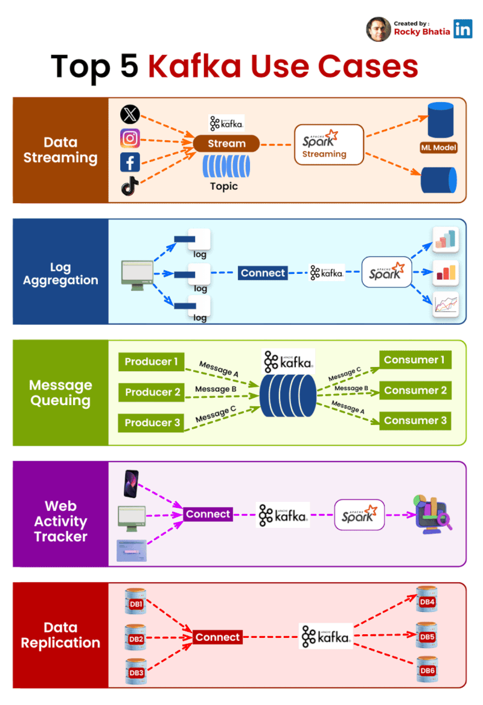
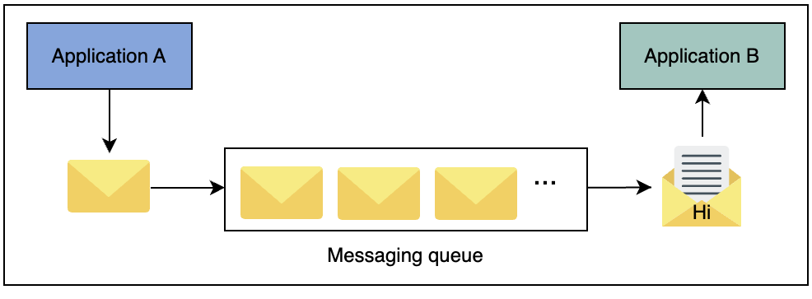

Distributed Messaging Queue

Slide 22
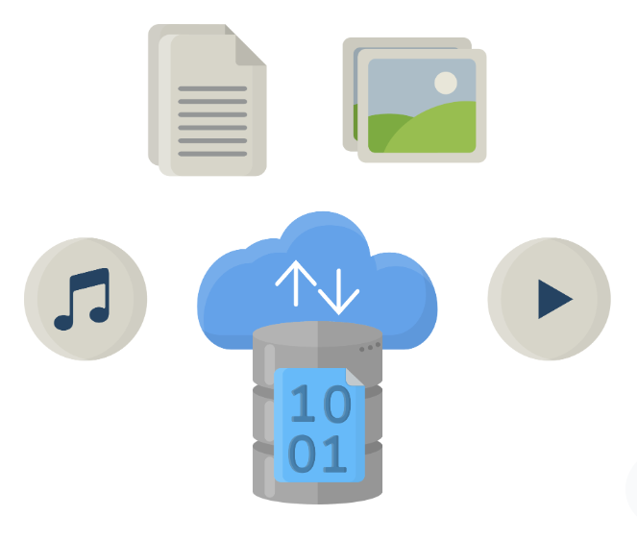
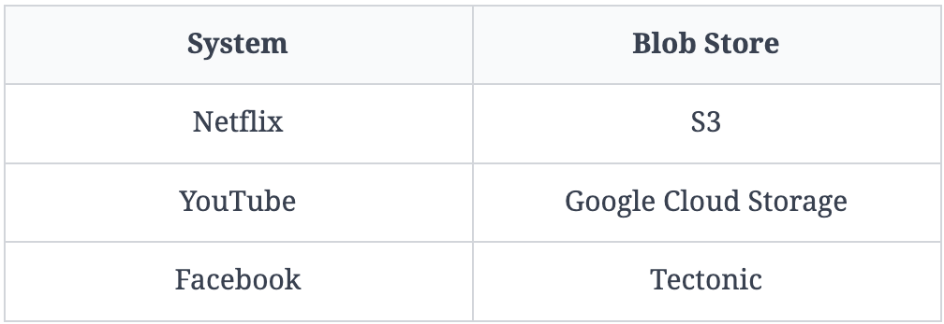
Blob Store

Slide 23
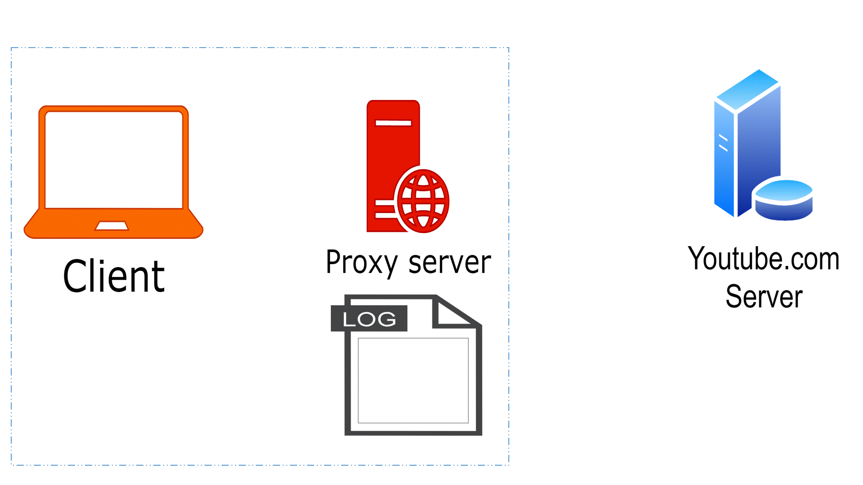
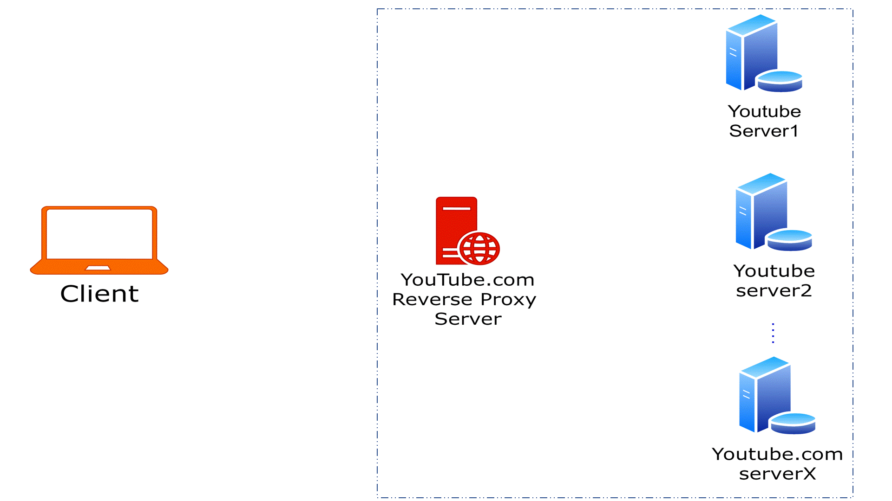
Proxies

Slide 24
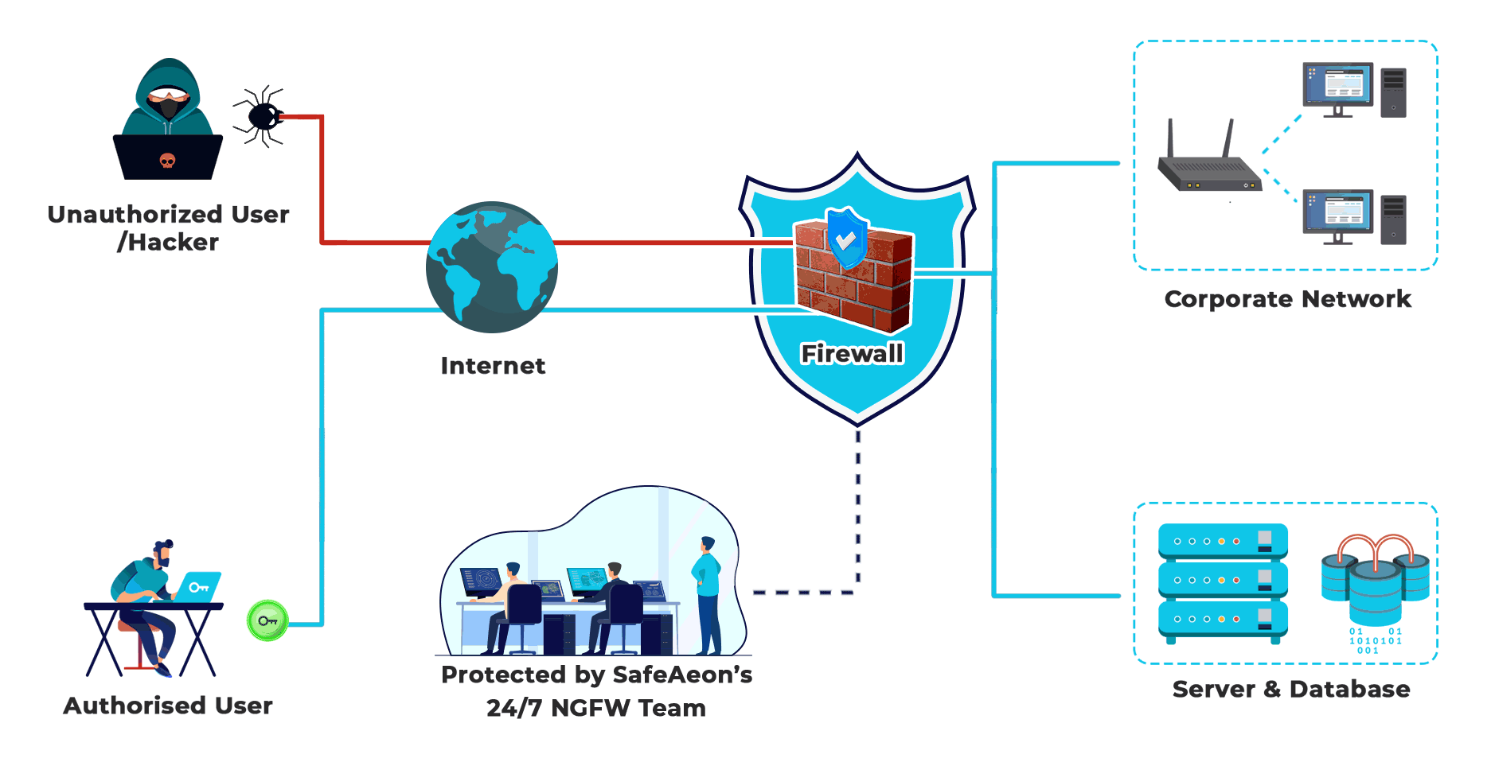
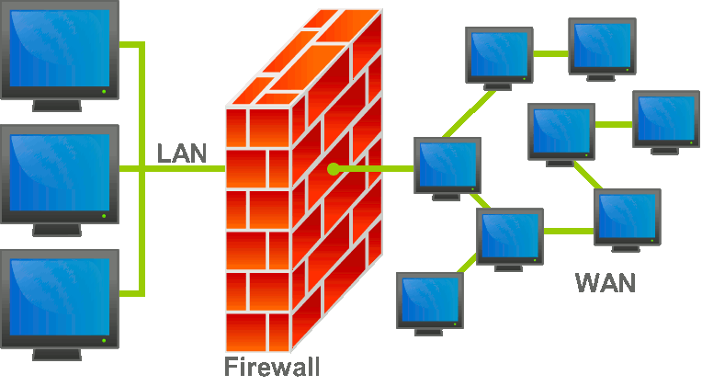
Firewall & Intrusion detection systems

Slide 25

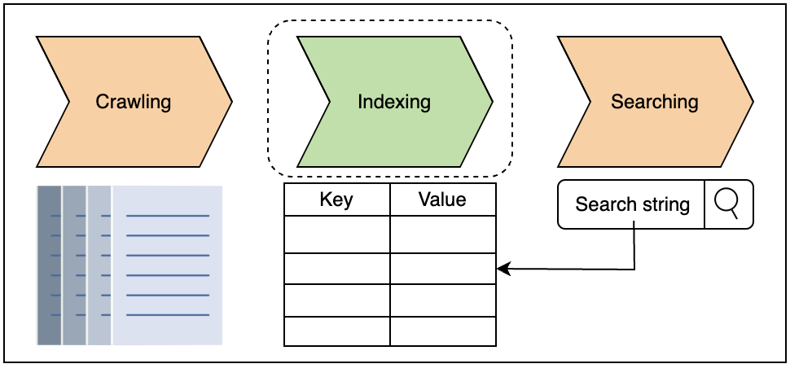
Distributed Search: Elastic Search

Slide 26
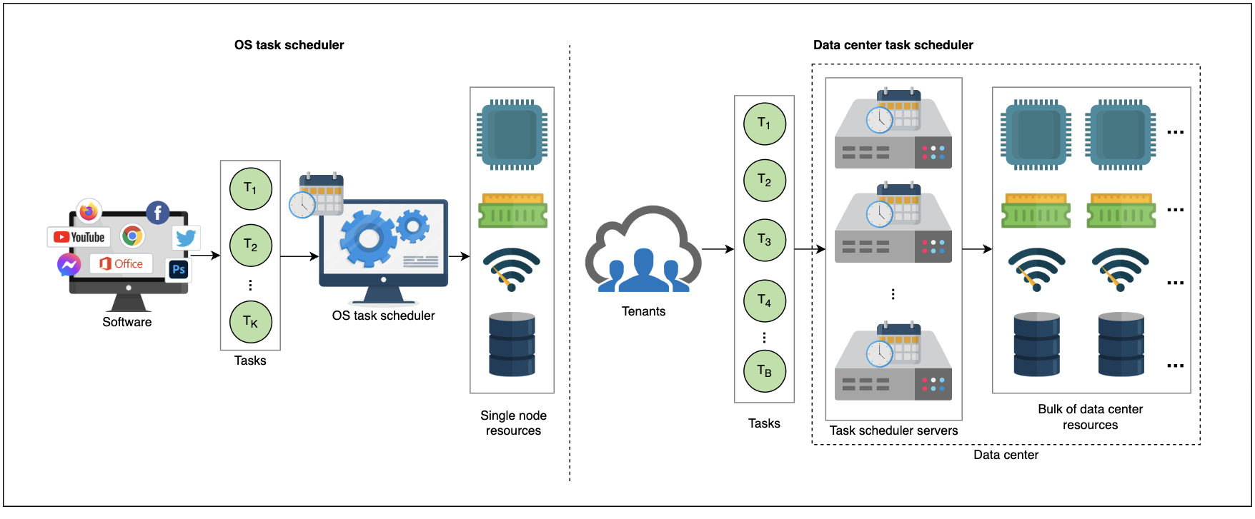
Distributed Task Scheduler

Slide 27
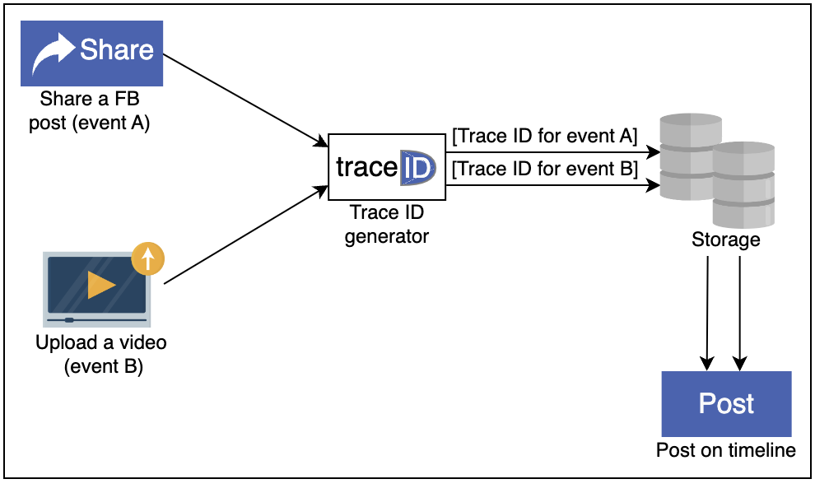
Sequencer: Unique ID generator

Slide 28
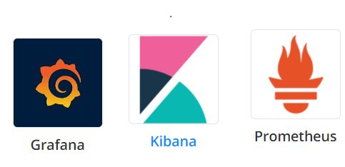
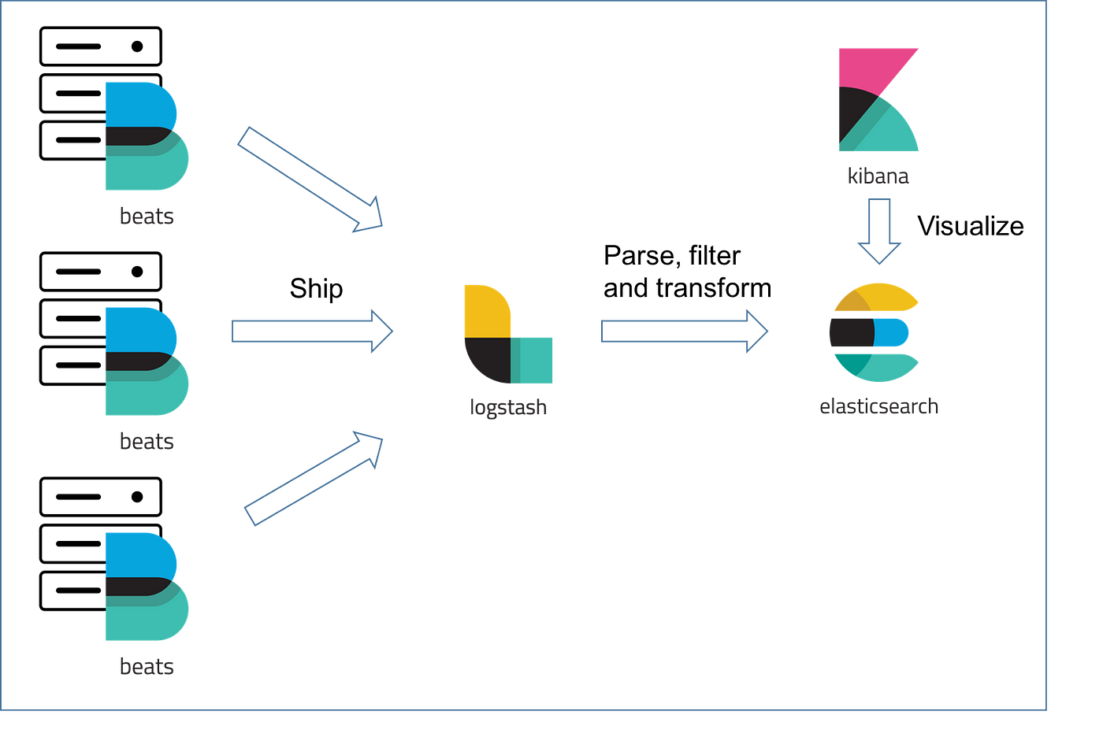

Monitoring

Slide 29
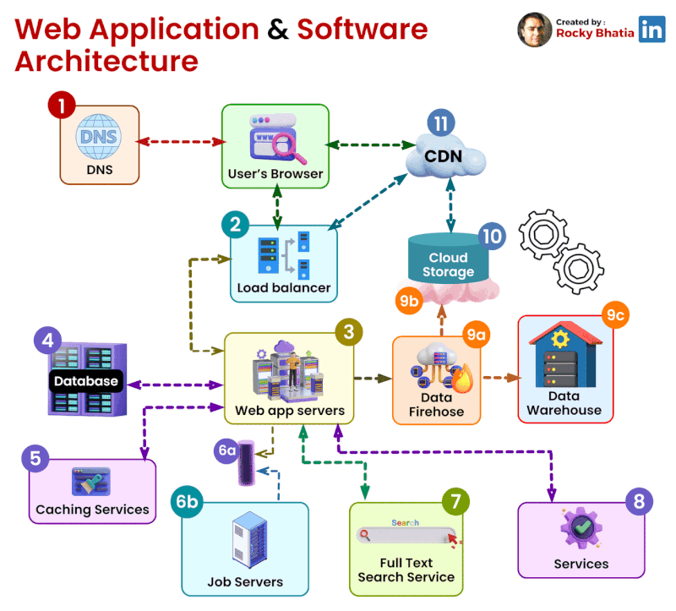
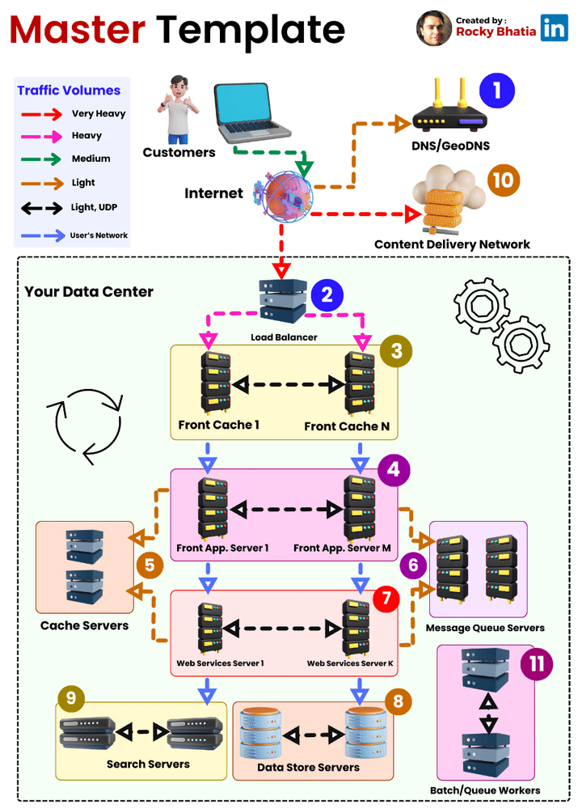
Web Application Software Architecture

Slide 30
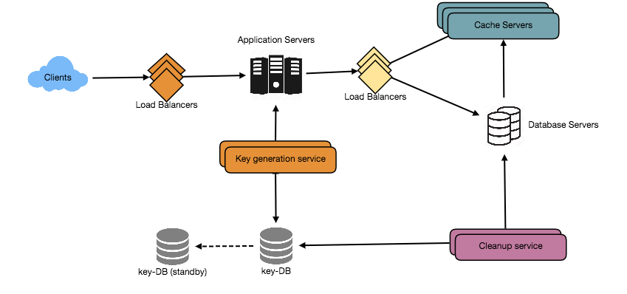
Designing URL Shortening service like TinyURL
Image by Shutterstock

Slide 31
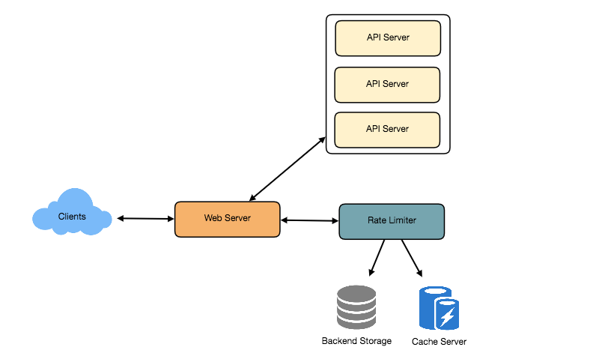
Designing an API Rate Limiter
Image by Shutterstock

Slide 32
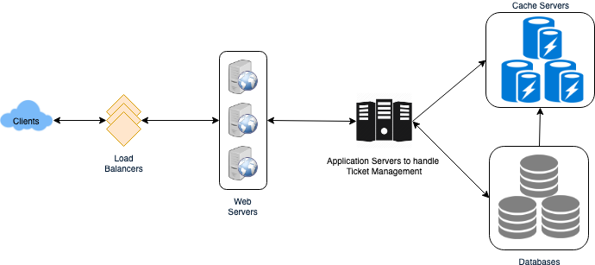
Design Ticketmaster
Image by Shutterstock

Slide 33
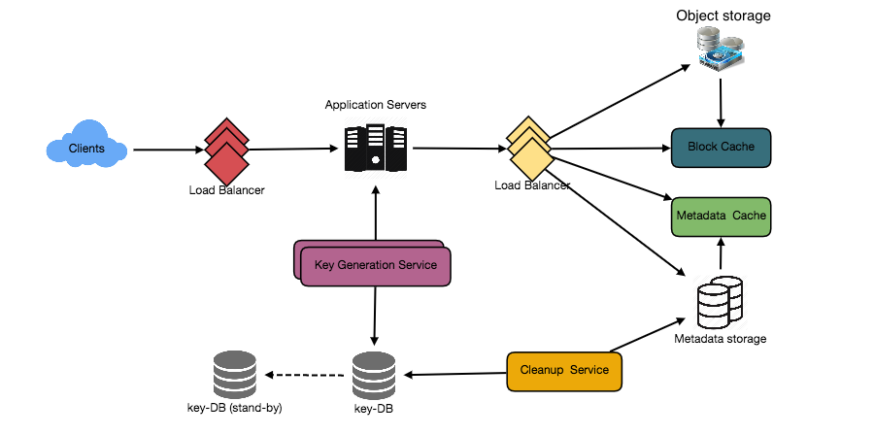
Designing Pastebin
Image by Shutterstock

Slide 34
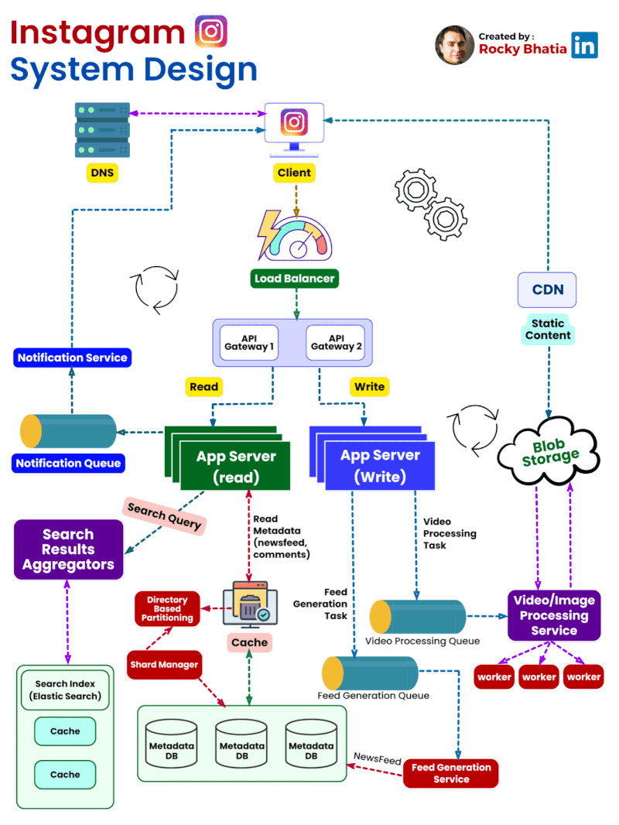
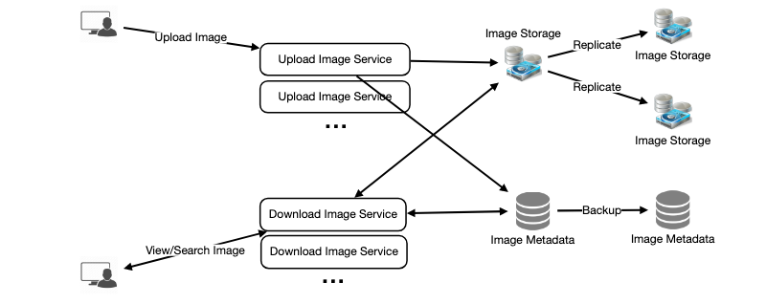
Designing Instagram
Image by Shutterstock

Slide 35
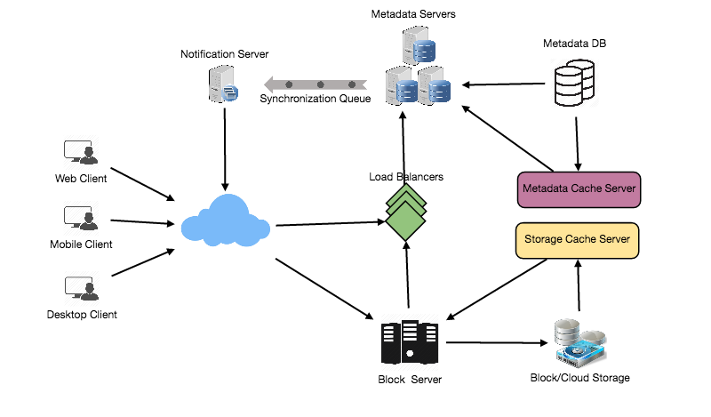
Designing Dropbox
Image by Shutterstock

Slide 36
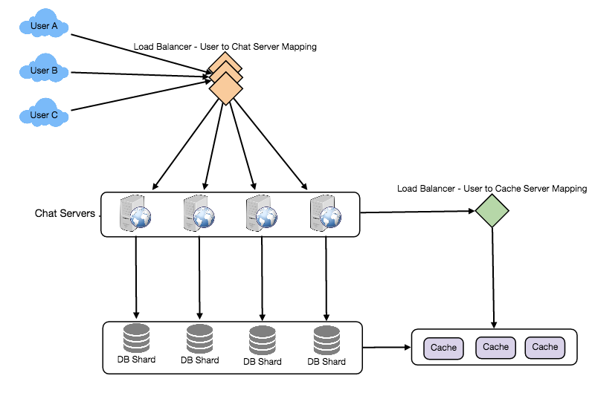
Designing Facebook Messenger
Image by Shutterstock

Slide 37
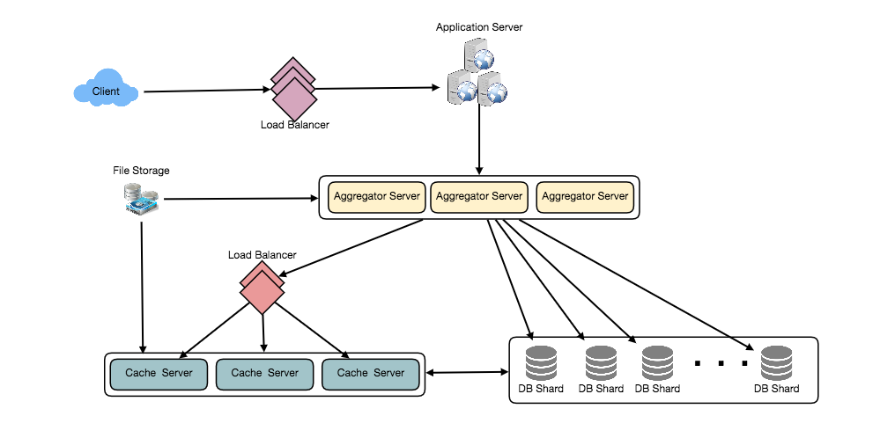
Designing Twitter
Image by Shutterstock

Slide 38

Designing Youtube
Image by Shutterstock

Slide 39

Designing Netflix
Image by Shutterstock

Slide 40

Designing a Web Crawler
Image by Shutterstock

Slide 41

Designing Uber backend
Image by Shutterstock

Slide 42


Designing Facebook
Image by Shutterstock

Slide 43

Sorular

